Slide 1


Managing Online Reviews
and Dealing With
Potential PR Challenges
Speakers
Bill Faeth of Inbound Marketing Agents/Limo University
Faith Glasgow of Peak Limousine

Slide 2


MANAGING ONLINE REVIEWS
& POTENTIAL PR CHALLENGES
presented by Bill Faeth & Faith Glasgow

Slide 3

RULES OF ENGAGEMENT
Always respond
Have a plan (pre-draft responses)
Be consistent
Track everything
Be personal and friendly
Empower your team to respond
Always be listening

Slide 4

ALWAYS RESPOND
A lack of response is actually a response. It’s a response that says, “We don’t care about very much.”
Respond to every comment
Respond within an hour

Slide 5
Have a plan in place.
Empower your employees to respond by drafting responses and comments ahead of time.

Slide 6
Be consistent.

Slide 7
It’s important for every customer representative to be on the same page when responding.
Notes:
This is where tracking responses (#4) and having some responses prepared ahead of time (#2) can save a lot of time and prevent customer service headaches.

Slide 8
Tracking social activity can help you better serve your customers.

Slide 9
ACCOUNTS TO TRACK
Yelp
Google
Faecbook
Trip Advisor
City Search
Bing
Twitter
LinkedIn
Wedding Wire
The Knot
Local Review Sites

Slide 10
ADD REVIEWS & COMMENTS
Add both positive and negative comments to your client profile’s so your staff is in the know when communicating with your client’s.

Slide 11
Turn a negative into a positive
Be friendly and personal

Slide 12
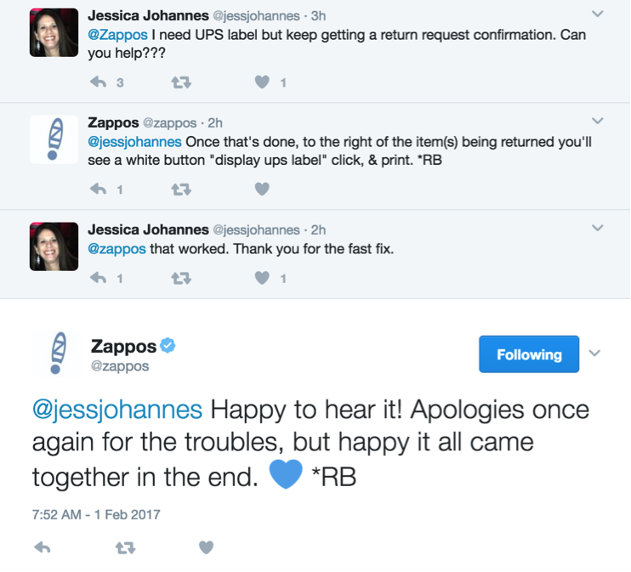
Companies like Zappos are nailing customer service by making interactions more friendly and personal.

Slide 13
Monitor competitor accounts and listen to what their customers are saying.
Notes:
To stay competitive, it’s just as important to listen to what people are saying about your competitors. Maybe people can’t say enough great things about Competitor X and their service, or maybe they’re getting berated with complaints — either way — knowing what customers and prospects like and don’t like is extremely valuable.

Slide 14
HANDLING NEGATIVE REVIEWS
Stay calm!
Turn the feeling of doom and obligation into a new-found opportunity.

Slide 15
HANDLING NEGATIVE REVIEWS
1. Don’t take a negative review personally
2. Don’t get defensive. Even if you are right.
3. Mind your reactions, tone, and choice of words
4. Move towards a resolution.
5. Diffuse the situation. Start with “I understand.”

Slide 16
HANDLING NEGATIVE REVIEWS
6. Always remember your response will be judged by future clients
7. Always respond. The worst thing you can do is NOT responding.
8. Studies show that not responding can lead to a 15% churn rate for existing customers.
9. Fake complaints - “I’m sorry, I do not have a record of us doing business.
Can you provide me with a confirmation number?
10. Move the conversation offline.

Slide 17
DOTTING THE I’S AND CROSSING THE T’S
1. Social media is just that - SOCIAL.
2. Stay positive. Be helpful and move the conversation forward.
3. Expect that a certain % of your audience is going to complain.
4. Be genuine in each response
5. Everything you do is a reflection of your brand
6. Try to assign one person to reply to all of your accounts to sustain consistency.
7. Always reply.

Slide 18

Q&A

Slide 19
Thank you for joining us!
Starting at 3:30 on the show floor:
Champagne Reception and Appetizers followed by unveiling of the 2018 Expedition and Navigator
at Ford-Lincoln Booth #500. Stay for Happy Hour at 5:30!

